Slide 1
HCI For Games
Understanding human-computer interfaces for games
By Joseph Roper

Slide 2
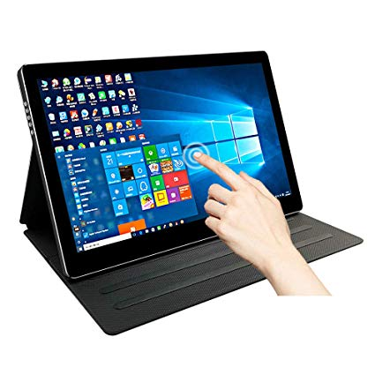
Technologies - Screens & Touch Screens
Description: It is a device that can recognise touch as an input.
Where it is used: Smart phones, drawing tablets and other tablets.
Advantages: Easy to use, easily accessible and can be small or large.
Disadvantages: Input sensitivity can vary, can get dirty, not great for games and not very accurate.

Slide 3
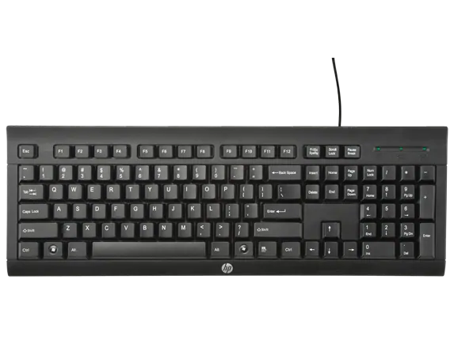
Technologies - Keyboards
Description: It’s a device with keys that when pressed down will perform inputs
Where it is used: Computers and laptops.
Advantages: Easy to use quickly, contains every letter of the alphabet and most of the punctuation.
Disadvantages: Keys can get stuck, different types of keyboard layouts (QWERTY, AZERTY, etc)

Slide 4
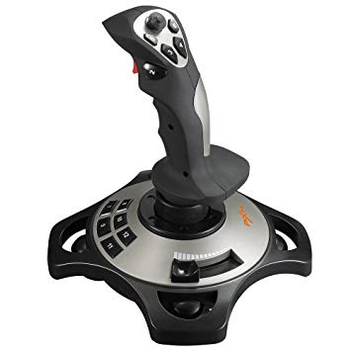
Technologies - Joysticks
Description: It is a controller most commonly used on airships however has been integrated for games the player can move around the stick to control the character and press the buttons to make up for other actions.
Where it is used: Aircrafts and with game consoles & Arcades
Advantages: Easy to use, Accurate, ergonomic, great for flying simulators.
Disadvantages: Cannot type with the controller quickly and it can only be integrated well with flying games.

Slide 5
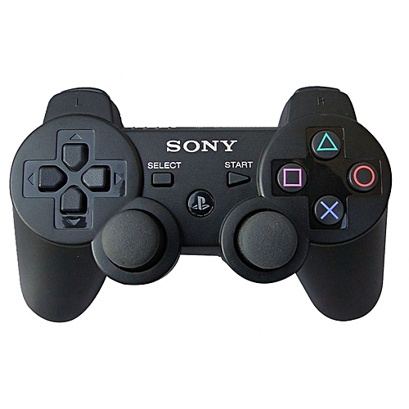
Technologies - Control Pads
Description: These are the main types of controllers used in current day as it has all the necessary buttons for playing any game.
Where it is used: Consoles.
Advantages: Ergonomic, No delay and has a good button layout.
Disadvantages: Hard to type quickly and some can break easily.

Slide 6
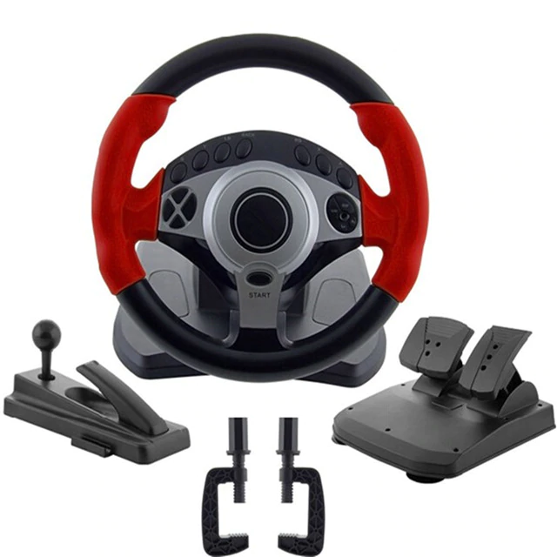
Technologies - Steering Wheels
Description: It is a controller that resembles the steering wheel of a car. It is integrated with racing games and usually comes with additional controllers such as a pedal that resembles the braking pad.
Where it is used: Racing Games.
Advantages: Immersive and ergonomic.
Disadvantages: Does not integrate well with any other game genre.

Slide 7
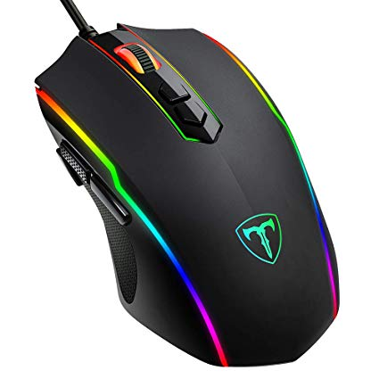
Technologies - Mouses
Description: This is a controller that has a sensor on the bottom of it that tracks movement meaning you can move the device up and it will input that movement into the computer for example if you were playing a game and moved your mouse it would move the players camera in correlation with the mouses movements.
Where it is used: Computers
Advantages: Fast/minimal delay, accurate integrated well with all computers, games and websites and they are readily available
Disadvantages: Can break easily and some can be faulty from brand new.

Slide 8
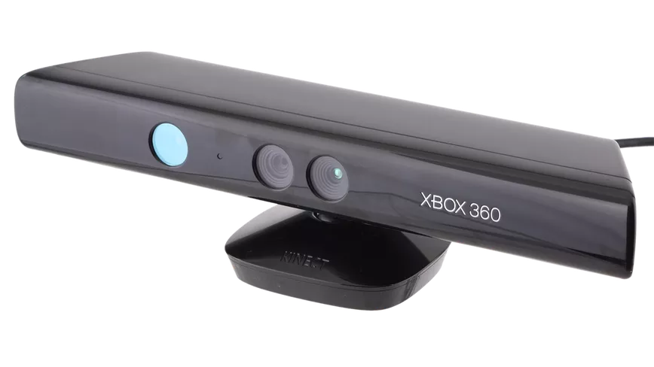
Technologies - Motion Detectors
Description: This is a device containing multiple cameras and depth sensors to track movement from the user inputting the information into the computer attached to the device. This can be used with games for example it can track when you jump through the cameras and input it into the game making your ingame character jump.
Where it is used: Consoles
Advantages: Fun and innovative
Disadvantages: Has input delay, not that accurate and is not integrated into tasks other that games.

Slide 9
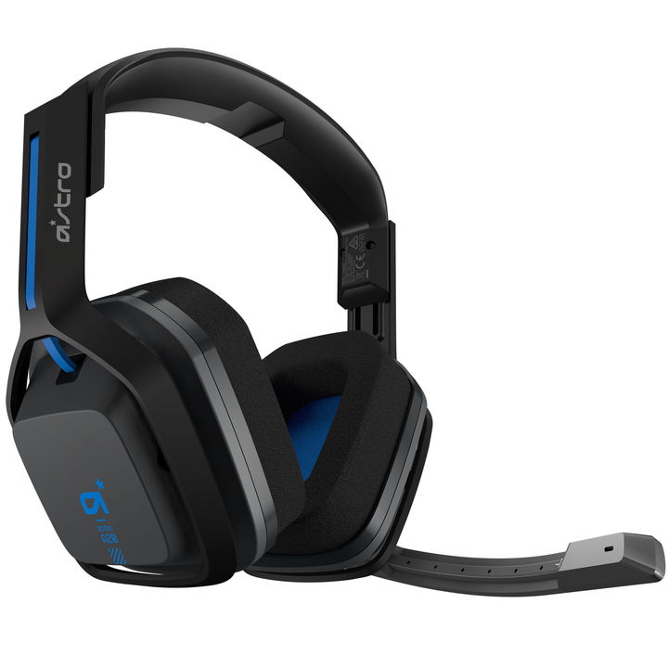
Technologies - Headsets
Description: This is a pair of speakers that sit on yours ears outputting sound from the users device. They usually have a microphone built into the device so that you can speak to your friends while playing games.
Where it is used: Computers and consoles
Advantages: Provides an immersive experience, is useful and ergonomic.
Disadvantages: Some can be uncomfortable or have a bad microphone.

Slide 10
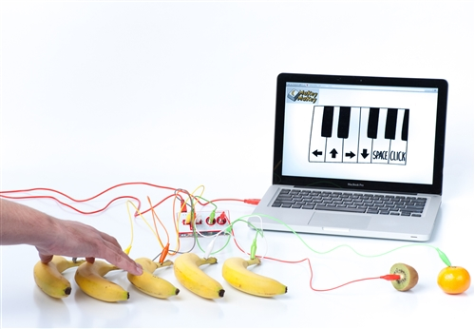
Technologies - Weirdest Controller (Makey Makey)
Description: It is a circuit board that you can attach to different items such as fruit or playdough using crocodile clips, which turns the items into input devices.
Where it is used: Science fairs and schools.
Advantages: Fun
Disadvantages: Can be messy and has a lot of input lag.

Slide 11
Interfaces - Command Line Interface & Graphical User Interface
Description: CLI’s are how we used to interact with computers by typing out instructions that the computer would then follow. GUI’s are how we interact with our devices now with clickable images that will send the command to the computer without us having to see the process.
Where it is used: Computers and all smart devices
CLI Advantages: The computer will process the information quicker as you are already typing in an easily convertible language.
GUI Advantages: It is easier for the user to operate as everything is turned into shortcuts.
CLI Disadvantages: It is difficult to operate and remember the language.
GUI Disadvantages: Can clutter the users desktop background. Not as fast as CLI.

Slide 12
Interfaces - Speech Recognition
Description: speech recognition is when you speak into a microphone and the computer can understand what you are saying by turning your voice into data and then processing it into actions. For example if I ask my Amazon Echo Dot “What time is it?” it will turn my voice into data that the device can read and then compare the keywords to its database of questions and give an accurate response through its speaker, for example “ It is 12pm”.
Where is it used: Computers, consoles, phones, smart phones and smart home devices.
Advantages: Easy to use, fast, easier to process the information for yourself.
Disadvantages: Sometimes it can not recognise what you are saying, not integrated well with games.

Slide 13
Interfaces - Menu Selection & Methods of Selection
Description: This is where you can easily access shortcuts in game such as controller settings, where you can save and exit the game. Menus can also contain other useful information.
Where it is used: Computers, Smartphones, Consoles and games
Advantages: Is easily accessible and extremely useful.
Disadvantages: Can sometimes take too long to load up and could play distracting music or have a displeasing theme.

Slide 14
Interfaces - Sense Oriented
Description: This is when a device can recognise different senses for example a mobile phone can sense movement by using the built in gyroscope within the phone.
Where is it used: Smartphones, consoles and computers.
Advantages: It makes interacting with your device easier, allows for cool features to be added to the device for example with the Oneplus 7 Pro phones pop up camera, it retracts when the phone is dropped by receiving information from the phones gyroscope. This stops accidental damage to the camera.
Disadvantages: Sometimes there can be input lag, it can sometimes not be integrated well for example with the xbox 360’s kinect which never recognised the users voice or movements properly.

Slide 15
Interfaces - Intelligent Systems (AI)
Description: AI stands for artificial intelligence and basically means that the machine can learn on its own by making rapid prototypes of the task given changing different variables on each test until the task is solved.
Where is it used: It is used with smart assistants such as Google and Amazon’s Alexa, smartphones, smart cars and many more.
Advantages: Can be really useful.
Disadvantages: It requires too much information from the user such as location, camera access and the microphone to be useful that some people don't feel safe with it on.

Slide 16
Interfaces - Avatars (Character Manipulation)
Description: This is when you can press up on a controller which will be inputted into the device, processed by the machine as an action which will then be carried out resulting in the character moving forward.
Where is it used: Games
Advantages: It allows for easy movement of your ingame character.
Disadvantages: Sometimes there can be input lag or the input just isn't processed.

Slide 17
Human Factors - How Interfaces Change for the User
Expert - Regular - Occasional - Novice
Explanation: Depending on the skill or familiarity someone has with interfaces they would want the interface to suit their skill level for example a Novice would probably want the interface on their phone to have large icons which are easily accessible. An occasional user would want features that they won't use kept hidden away in their phone so that it didn't take up space and bother them. A regular user would want smaller icons so more of their apps that they use daily could be shown on the screen and have access to features like changing the brightness of their screen. An expert would want access to all the features available with their device so that they would be able to tweak it to make it the best phone for them, they would have access to options such as screen colour temperature.
Advantage: The advantage of having different UI’s is that each user can have the best experience tailored to their skill level.
Disadvantage: A disadvantage of having different UI’s for each user is that because the UI for a novice would hide away features it would make it very difficult for a novice to progress and start getting used to more advanced AI’s.

Slide 18
Human Factors - How Interfaces Change for the User
Vision Impaired - Physically Impaired - Learning Difficulties
Explanation: Interfaces are also adapted for the less abled. For users with impaired vision they would use a UI that had big icoms with large text. It could also read out text messages for the user. For the physically impaired who can’t type the interface would allow the user to turn their speech into text using the devices microphone. A UI built for a user with learning difficulties would have picture aids throughout the interface to help the user understand features such as a sun to make the screen brighter and a moon to make the screen darker.
Advantage: An advantage of these interfaces is that it makes devices more accessible to a wider audience.
Disadvantage: A disadvantage of having these interfaces is that someone has to keep updating them even if the user base for the interface is low.

Slide 19
Human Factors - How Interfaces Change for the User
Age - Gender
Explanation: Interfaces are also adapted for different age groups. For example with the Youtube interface their is a Child version that will only allow the user to watch family friendly content and restricts access to videos with swearing. For the elderly the UI would hide away features that would be used by the user such as developer mode and would also enlarge images and text.
Advantage: An advantage of this is that it makes the device or platform with the adaptive UI more accessible to the public it also makes the platform safer for younger age groups.
Disadvantage: A disadvantage of this is that the content for the child friendly Youtube will have to be constantly monitored.

Slide 20
User Interface Design Principles
Co-location of related elements
Explanation: When designing an interface it is key to have it be recognizable so that the player will know exactly where to look for the information they need at the time. For example mini maps are usually always in the same place across different game titles as it will comfort the player as they won’t need to learn a whole new user interface layout for another game.
Advantage: An advantage of this is that it saves time for the game developer to make a whole new in-game HUD layout.
Disadvantage: This can stop innovation as players will get used to the same layout and will not want any changes even if they are superior.

Slide 21
User Interface Design Principles
User’s Language, Meaningful Shortcuts
Explanation: Game interfaces should be clear and easy to understand so that the user can use the interface without putting great thought into their actions so that they can focus on the gameplay. Games should also have multiple language options so that everyone will be able to play and understand their game.
Advantage: An advantage of this is that it allows for a more enjoyable experience while playing.
Disadvantage: A disadvantage of this is that the developers will have to spend a lot of money and time to localise their game for different countries.

Slide 22
User Interface Design Principles
Avoidance of Distraction
Explanation: While playing a game and you access your inventory system to quickly select a weapon mid combat you don’t want any loud annoying music or flashing lights in the interface distracting you from the gameplay. This is why in-game interfaces should be inconspicuous and match the games theme so that the animations look fluid and seamless as to not avert the players eye from the action.
Advantage: An advantage of this is that it allows for seamless gameplay with no interactions.
Disadvantage: Disadvantages of this is that it’s hard to create an interface like this.

Slide 23
User Interface Design Principles
Clarity and Relevance
Explanation: Controller feedback can be a really useful tool for game developers to have the game communicate to the player informing them quickly by having the controller vibrate. Vibrations through the controller can also help immerse the player making them feel like the character on screen. An example of controller feedback used well in a video game is with Celeste a difficult platformer, in Celeste the controller vibrates when your character runs out of jumps quickly informing the player. Celeste also has the controller vibrate when the player dies for example by falling on a pit of spikes immersing the player to make them believe they are that character. This feedback is fast, efficient and consistent making it a perfect example of good in-game feedback.
Advantage: Advantages of feedback are that they can quickly inform the player about an event happening in the game such as the controller vibrating when you take damage.
Disadvantage: A disadvantage of in-game feedback is that if the feedback has a delay it can be really unhelpful and frustrating for the player to deal with. Also the player could just not like controller vibrations.

Slide 24
User Interface Design Principles
Undo, Redo, Inconsistent Input
Explanation: A good interface should allow for user error and have features to correct it for example in Photoshop you can press Ctrl + Z to undo the most recent change in the document. Photoshop also has the feature of a history tab where the user can look back into every action made and go back to correct errors.
Advantage: This is really useful as you can quickly undo mistakes for example when drawing rather than using the eraser tool provides a more fluid and fast workflow.
Disadvantage: A disadvantage of having these features is that you could accidentally go back too far in the history tab and lose your work.

Slide 25
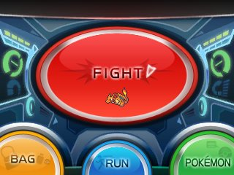
User Interface Design Principles
Uniformity, Reduction of User Memory Process
Explanation: In an ongoing game franchise it is key to keep the same basic interface with graphical improvements with each version so that the player doesn't have to relearn the interface layout allowing them to feel more comfortable with playing the game allowing for longer playtime. For example with the Pokemon franchise, each game has the same menu layout while in battle allowing the user to Fight, Run and access their bag or Pokemon.
Advantage: This is an advantage as it stops the player having to look for the different options.
Disadvantage: A disadvantage of this is that there can be no real improvement of the interface without backlash from the fans of the series.

